Slide 1
Región | Año 2025 (S/ ) | Año 2026 (S/ )
AMAZONAS | 45,120.00 | 70,610.00
ANCASH | 516,809.00 | 767,558.00
APURIMAC | 162,804.00 | 249,415.00
AREQUIPA | 2,493,012.00 | 3,363,578.00
AYACUCHO | 339,995.00 | 549,014.00
CAJAMARCA | 773,363.00 | 2,075,156.00
CALLAO | 1,112,177.00 | 2,021,392.00
CUSCO | 765,193.00 | 1,337,546.00
HUANCAVELICA | 61,703.00 | 155,092.00
HUANUCO | 412,283.00 | 507,989.00
ICA | 505,626.00 | 777,485.00
JUNIN | 3,925,018.00 | 6,856,101.00
LA LIBERTAD | 1,501,856.00 | 2,172,850.00
LAMBAYEQUE | 767,814.00 | 1,366,395.00
LIMA METROPOLITANA | 58,280,222.00 | 115,222,783.00
LIMA REGION | 594,755.00 | 789,833.00
LORETO | 563,876.00 | 1,120,481.00
MADRE DE DIOS | 64,390.00 | 0.00
MOQUEGUA | 100,721.00 | 156,540.00
PASCO | 43,009.00 | 132,553.00
PIURA | 1,070,108.00 | 2,083,883.00
PUNO | 179,152.00 | 158,304.00
SAN MARTIN | 300,727.00 | 421,375.00
TACNA | 519,612.00 | 268,357.00
TUMBES | 181,202.00 | 340,163.00
UCAYALI | 110,180.00 | 130,778.00
Total general (S/) | 75,390,727.00 | 143,095,231.00
Transferencias realizadas año 2025-2026
Incluye todos los conceptos transferidos en la actividad correspondiente a ERH: Prestaciones de salud y Prestaciones no tarifadas

Slide 2
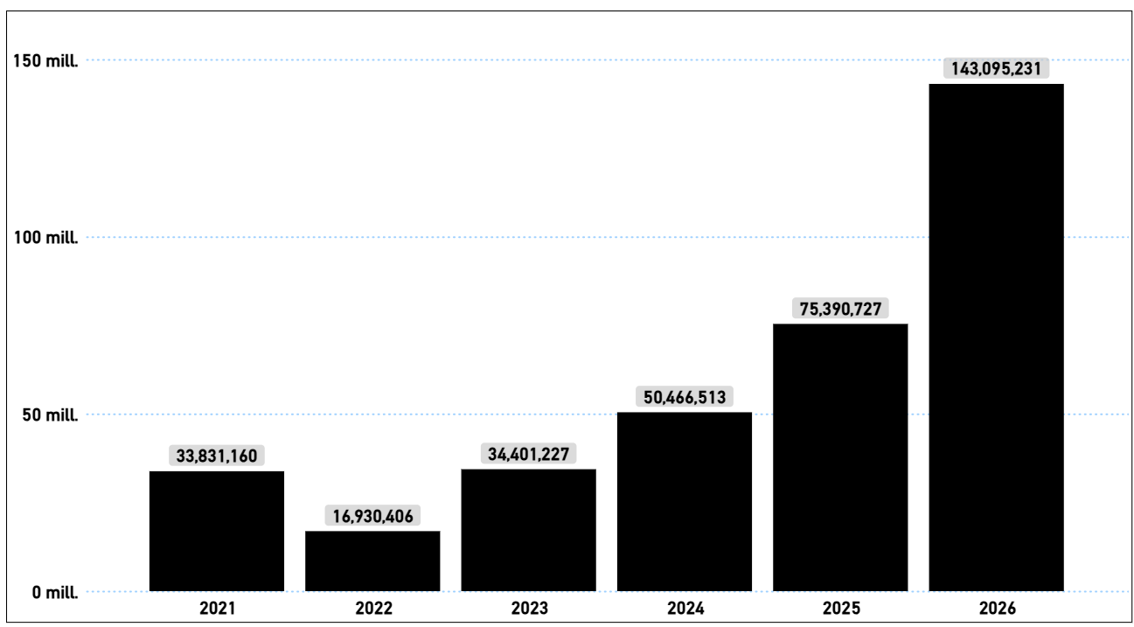
Evolución del financiamiento en ERH en el periodo 2021-2026

Slide 3
Ejecución de los recursos transferidos por el FISSAL por ERH
Ejecución de recursos transferidos por FISSAL al 31.12.2025
Regiones | PIM | Devengado | % Devengado | Saldo de Balance
AMAZONAS | 45,120.00 | 45,109.32 | 100% | 10.68
ANCASH | 584,662.00 | 581,819.71 | 100% | 2,842.29
APURIMAC | 165,028.00 | 164,993.78 | 100% | 34.22
AREQUIPA | 2,560,521.00 | 2,551,439.57 | 100% | 9,081.43
AYACUCHO | 558,806.00 | 423,192.44 | 76% | 135,613.56
CAJAMARCA | 570,046.00 | 510,022.44 | 89% | 60,023.56
CALLAO | 1,376,227.00 | 1,177,045.24 | 86% | 199,181.76
CUSCO | 984,445.00 | 969,395.86 | 98% | 15,049.14
HUANCAVELICA | 65,837.00 | 65,833.67 | 100% | 3.33
HUANUCO | 266,633.00 | 266,631.34 | 100% | 1.66
ICA | 605,643.00 | 560,754.02 | 93% | 44,888.98
JUNIN | 3,951,066.00 | 3,949,326.84 | 100% | 1,739.16
LA LIBERTAD | 1,322,830.00 | 962,031.86 | 73% | 360,798.14
LAMBAYEQUE | 979,549.00 | 948,666.00 | 97% | 30,883.00
LIMA METROPOLITANA | 60,373,121.00 | 56,658,444.49 | 94% | 3,714,676.51
LIMA REGIÓN | 627,487.00 | 627,259.74 | 100% | 227.26
LORETO | 557,891.00 | 522,092.34 | 94% | 35,798.66
MADRE DE DIOS | 97,611.00 | 95,453.80 | 98% | 2,157.20
MOQUEGUA | 102,582.00 | 102,570.76 | 100% | 11.24
PASCO | 43,009.00 | 43,005.90 | 100% | 3.10
PIURA | 1,188,569.00 | 1,179,561.06 | 99% | 9,007.94
PUNO | 191,597.00 | 116,211.34 | 61% | 75,385.66
SAN MARTIN | 343,234.00 | 332,662.30 | 97% | 10,571.70
TACNA | 553,198.00 | 552,373.50 | 100% | 824.50
TUMBES | 216,803.00 | 214,544.20 | 99% | 2,258.80
UCAYALI | 110,542.00 | 88,976.08 | 80% | 21,565.92
Total general | 78,442,057.00 | 73,709,417.60 | 94% | 4,732,639.40
Ejecución de recursos transferidos por FISSAL al 09.02.2026
Regiones | PIM | Certificado | % Certificado | Devengado
AMAZONAS | 70,610.00 | 0.00 | 0% | 0.00
ANCASH | 767,558.00 | 0.00 | 0% | 0.00
APURIMAC | 249,415.00 | 0.00 | 0% | 0.00
AREQUIPA | 3,326,640.00 | 0.00 | 0% | 0.00
AYACUCHO | 549,014.00 | 0.00 | 0% | 0.00
CAJAMARCA | 2,075,156.00 | 745,778.88 | 36% | 0.00
CALLAO | 2,031,071.00 | 0.00 | 0% | 0.00
CUSCO | 1,337,546.00 | 0.00 | 0% | 0.00
HUANCAVELICA | 155,092.00 | 0.00 | 0% | 0.00
HUANUCO | 507,989.00 | 0.00 | 0% | 0.00
ICA | 777,485.00 | 0.00 | 0% | 0.00
JUNIN | 6,856,101.00 | 0.00 | 0% | 0.00
LA LIBERTAD | 2,172,850.00 | 0.00 | 0% | 0.00
LAMBAYEQUE | 1,366,395.00 | 0.00 | 0% | 0.00
LIMA METROPOLITANA | 116,729,514.00 | 710,300.00 | 1% | 0.00
LIMA REGIÓN | 789,833.00 | 0.00 | 0% | 0.00
LORETO | 1,120,481.00 | 0.00 | 0% | 0.00
MADRE DE DIOS | 0.00 | 0.00 | 0% | 0.00
MOQUEGUA | 156,540.00 | 0.00 | 0% | 0.00
PASCO | 132,553.00 | 0.00 | 0% | 0.00
PIURA | 2,083,883.00 | 0.00 | 0% | 0.00
PUNO | 158,304.00 | 0.00 | 0% | 0.00
SAN MARTIN | 421,375.00 | 0.00 | 0% | 0.00
TACNA | 268,357.00 | 0.00 | 0% | 0.00
TUMBES | 340,163.00 | 0.00 | 0% | 0.00
UCAYALI | 30,374.00 | 0.00 | 0% | 0.00
Total general | 144,474,299.00 | 1,456,078.88 | 1% | 0.00

